Slide 1
Improving Zmm selection in ATLAS using LightGBM
Sara Dahl Andersen
with Malte Algren and Mads Storr-Hansen
Under supervision of Troels Petersen
Niels Bohr Institute, University of Copenhagen

Slide 2
Long term goal
Improve Higgs channels: H ➝ Zγ, H ➝ γ*γ, H ➝ ZZ*

Slide 3
Long term goal
Improve Higgs channels: H ➝ Zγ, H ➝ γ*γ, H ➝ ZZ*
Current goal
Improve selection in Z ➝ mm for both MC and Data
Soon move on to Z ➝ mmγ

Slide 4
Outline
Models on Monte Carlo data to get Zmm model for muon pairs: Similar approach as Troels just talked about
ML PID and Isolation models for single muons
ML Zmm model (ML PID and ML ISO serves as input)
Moving on to Data
(Try to create) ML PID and Isolation models on Data
Using the Monte Carlo based Zmm model on Data with ML PID and ML ISO as input
Evaluating the performance on Data

Slide 5
Data
MC:
Signal:
mc16_13TeV.361107.PowhegPythia8EvtGen_AZNLOCTEQ6L1_Zmumu.deriv.DAOD_MUON1.e3601_e5984_s3126_r10201_r10210_p3629
Background:
mc16_13TeV.361101.PowhegPythia8EvtGen_AZNLOCTEQ6L1_Wplusmunu.deriv.DAOD_MUON1.e3601_e5984_s3126_r10724_r10726_p3629
mc16_13TeV.361250.Pythia8B_A14_NNPDF23LO_bbTomu15.deriv.DAOD_MUON1.e3878_e5984_s3126_r10724_r10726_p3629
Eventually we would include Zmmgam files to get low pt muons
Data:
data18_13TeV.00349693.physics_Main.deriv.DAOD_MUON1.f933_m1960_p3553

Slide 6
LightGBM
All models are created using the framework LightGBM
Tree-based models
Boosing: gradient boosting decision tree
Parameters are not hyperparameter optimized (yet!!)

Slide 7
MC model on muons We create two ML models on single muons: Particle identification (PID) Isolation (ISO)

Slide 8
MC model on single muons: PID
Particle identification (PID) model:
Signal selection: truthPgdId = 13 (muons)
Variables used in the model:
We have tested all PID variables and found the most important according to SHAP ranking.
﻿muo_numberOfPrecisionLayers | muo_numberOfPrecisionHoleLayers
muo_MuonSpectrometerPt | muo_ET_TileCore
muo_scatteringCurvatureSignificance | muo_scatteringNeighbourSignificance
muo_momentumBalanceSignificance | muo_energyLossType
muo_EnergyLoss | muo_deltatheta_1
muo_quality
Notes:
Måske ikke med

Slide 9
MC model on single muons: PID
Particle identification (PID) model:
Needs hyperparameter optimization
Notes:
Investigate

Slide 10
MC model on single muons: ISO
Isolation (Iso) model:
Signal selection: truthOrigin = 13 (Z)
Variables used in the model:
﻿muo_ptconecoreTrackPtrCorrection | muo_ptcone20
muo_etconecoreConeEnergyCorrection | muo_etcone20
muo_neflowisolcoreConeEnergyCorrection | muo_pt
muo_topoetconecoreConeEnergyCorrection
Notes:
Måske væk

Slide 11
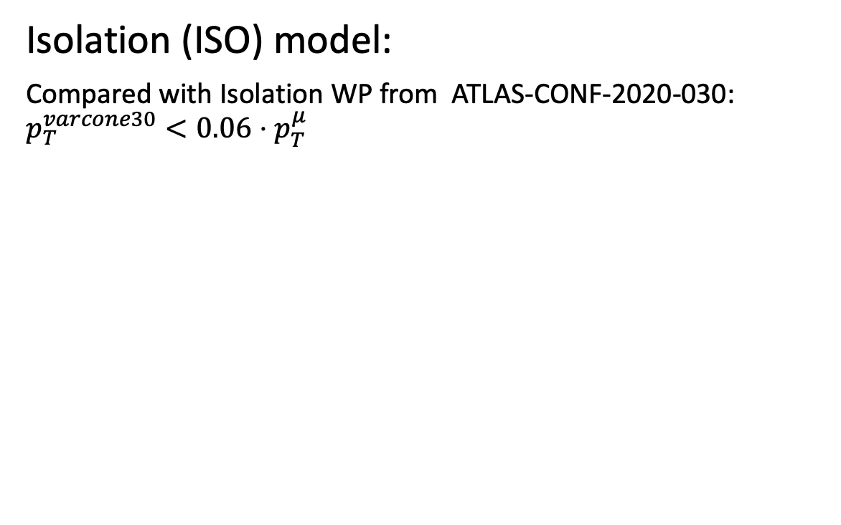
MC model on single muons: ISO
Isolation (ISO) model:
Compared with Isolation WP from ATLAS-CONF-2020-030: $p_{T}^{varcone30}<0.06⋅p_{T}^{μ}$
Notes:
Change the ptvarcone plot

Slide 12
MC model on single muons: ISO
Isolation (ISO) model:
Compared with Isolation WP from ATLAS-CONF-2020-030: $p_{T}^{varcone30}<0.06⋅p_{T}^{μ}$
Notes:
Change the ptvarcone plot

Slide 13
MC model on Zmm Model for muon pairs originating from the Z boson
The two models for single muons will be used as input to the Zmm model
The two muons in the Z -> mm decay will each recieve a score from the ML models
The scores are used as variables in the LGBM model

Slide 14
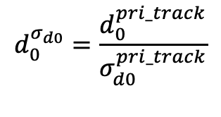
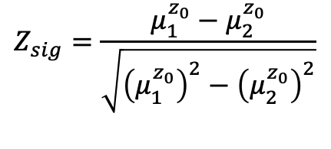
MC model on Zmm: variables
$$Z_{sig}=\frac{μ_{1}^{z_{0}}−μ_{2}^{z_{0}}}{\sqrt{{\left(μ_{1}^{z_{0}}\right)}^{2}−{\left(μ_{2}^{z_{0}}\right)}^{2}}}$$
Signal: Muon pairs originating from Z w. opposite sign
Background: Muon pairs not originating from Z
Training set:
nSig: 50k, nBkg: 270k
Validation set:
nSig: 11k, nBkg: 70k
$$d_{0}^{σ_{d0}}=\frac{d_{0}^{pri_track}}{σ_{d0}^{pri_track}}$$
Event variables
﻿correctedScaledAverageMu | NvtxReco | Z_sig
Muon variables (exists for both muons)
muo_ISO_score | muo_PID_score | muo_d0_d0Sig
muo_priTrack_d0 | muo_priTrack_z0
Notes:
Signal selection with numbers

Slide 15
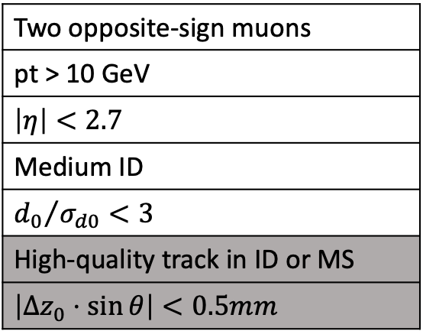
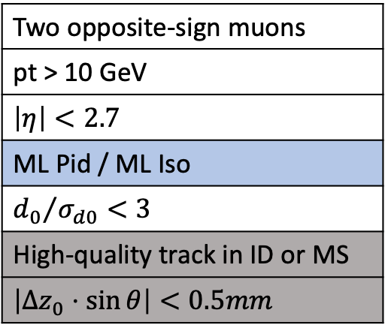
MC model on Zmm: comparing with ATLAS
Using ATLAS selection from ﻿﻿arXiv: 2005.05382
Modified ATLAS selection from ﻿﻿arXiv: 2005.05382
Modified ML Zmm model
﻿Two opposite-sign muons
pt > 10 GeV
$$\left|η\right|<2.7$$
Medium ID
$${d_{0}}/{σ_{d0}}<3$$
﻿High-quality track in ID or MS
$$\left|Δz_{0}⋅\sin{θ}\right|<0.5mm$$
﻿Two opposite-sign muons
pt > 10 GeV
$$\left|η\right|<2.7$$
ML Pid / ML Iso
$${d_{0}}/{σ_{d0}}<3$$
﻿High-quality track in ID or MS
$$\left|Δz_{0}⋅\sin{θ}\right|<0.5mm$$
﻿correctedScaledAverageMu
NvtxReco
Z_sig
Medium ID
muo_d0_d0Sig
muo_priTrack_z0
muo_priTrack_d0
Notes:
Måske ikke vise det i ikke kan finde ud af ☺

Slide 16
MC model on Zmm: prediction
Notes:
60-120

Slide 17
MC model on Zmm: prediction
Range of invariant mass:
80 < invM < 100
Notes:
80-100 only
Plot background for Zmm LH

Slide 18
ML models on Data PID and ISO models
Notes:
Find på noget andet end dasta

Slide 19
Machine Learning on Data: Event selection
Tag and probe selection:
Tag: Trigger muon + Tight ID
Tag and probe pair
Check their sign and Z mass range
accept if +/- 5 GeV from Z
Save only the probe muon
Background is same-sign muons
Unused is opposite-sign muons outside
Z mass range
Unused
Notes:
Trash: unused

Slide 20
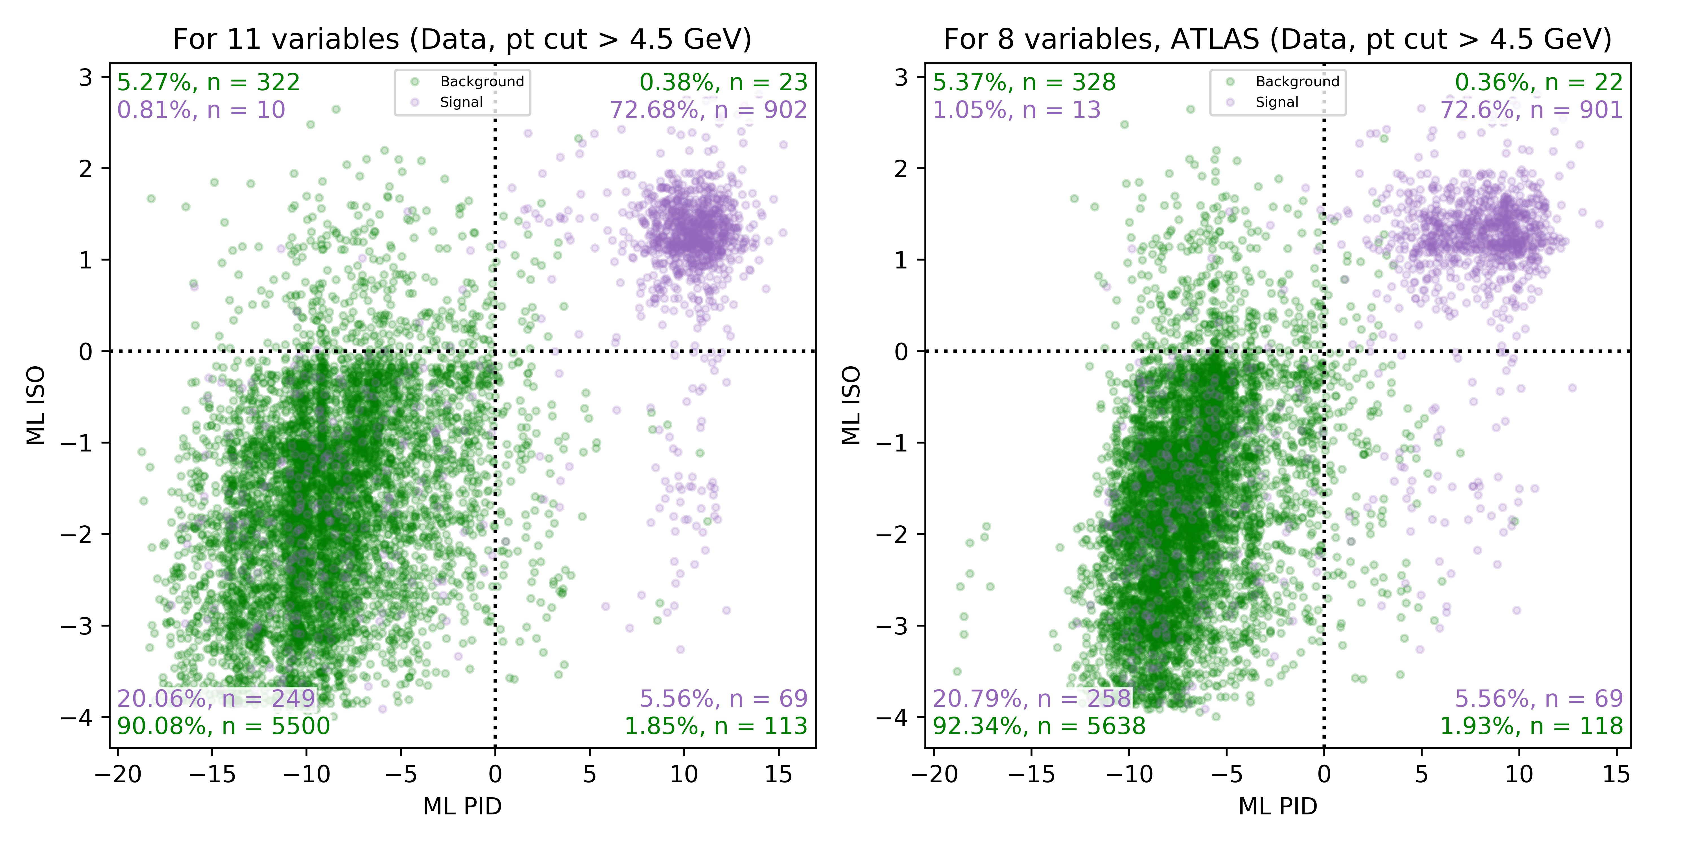
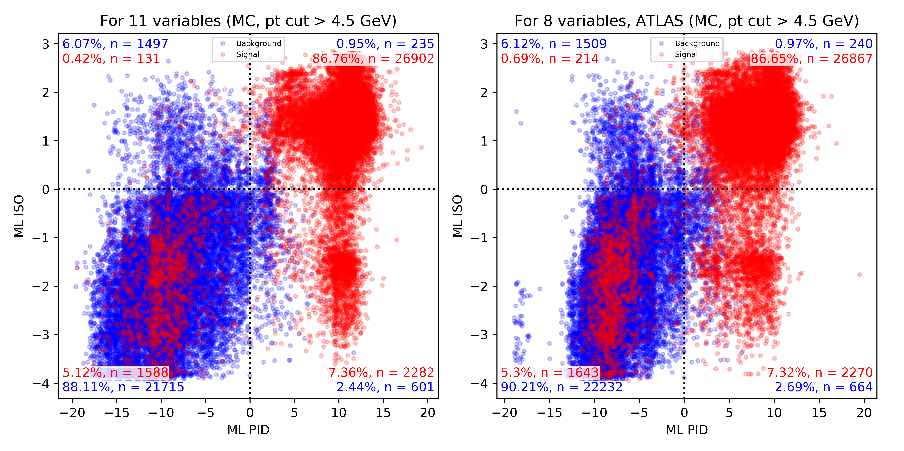
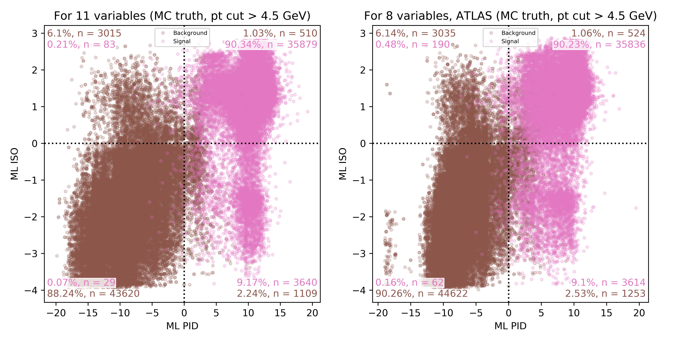
Machine Learning on Data: scoring using MC models
We use the T&P selection on both Data and MC and compare with MC truth
Data
MC
MC
truth
From the MC truth plot, we can conclude that the data can be cleaned further before it is used in PID and ISO models

Slide 21
Machine Learning on Data: ML models
PID dataset: We cut in the ML Iso variable
ISO dataset: We cut in the ML Pid variable

Slide 22
Zmm model on Data Model for muon pairs originating from the Z boson
We will use the ML Pid and ML Iso as input to the model as before
Evaluating the model on Data

Slide 23
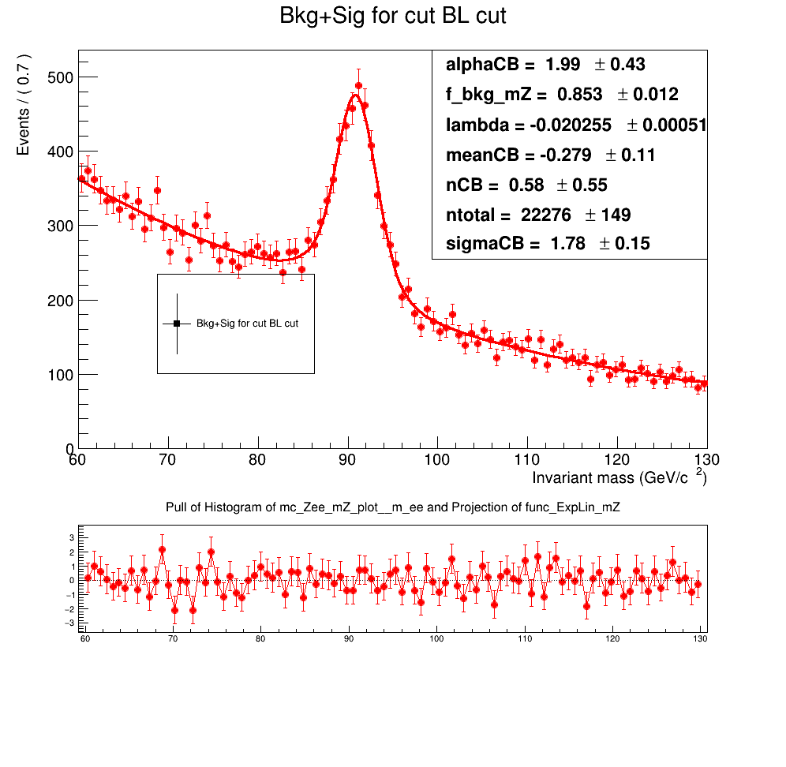
Machine Learning on Data: Event selection
We will not use tag & probe, as we need muon pairs
Instead we only look at sign of the muons:
Same-sign muons: Definetly background
Opposite-sign muons: Some are signal while some are background
Numbers extracted from fit:
nSig: 3.274
nBkg: 19.001
Plot: Fit of opposite-sign muons
Notes:
Insert fit of opposite sign

Slide 24
Machine Learning on Data same-sign: Prediction compared with MC background
Isolation PID
Score of Isolation ML model for Data compared with score of Isolation ML model for MC
Score of PID ML model for Data compared with score of PID ML model for MC
We will use MC model for data as well for now, we might have a solution for this: transforming the MC distribution
Notes:
Overskrift

Slide 25
Machine Learning on Data: variables
Get more background!
Notes:
More MC background -> ☺

Slide 26
Machine Learning on Data: LGBM model
MC Data

Slide 27
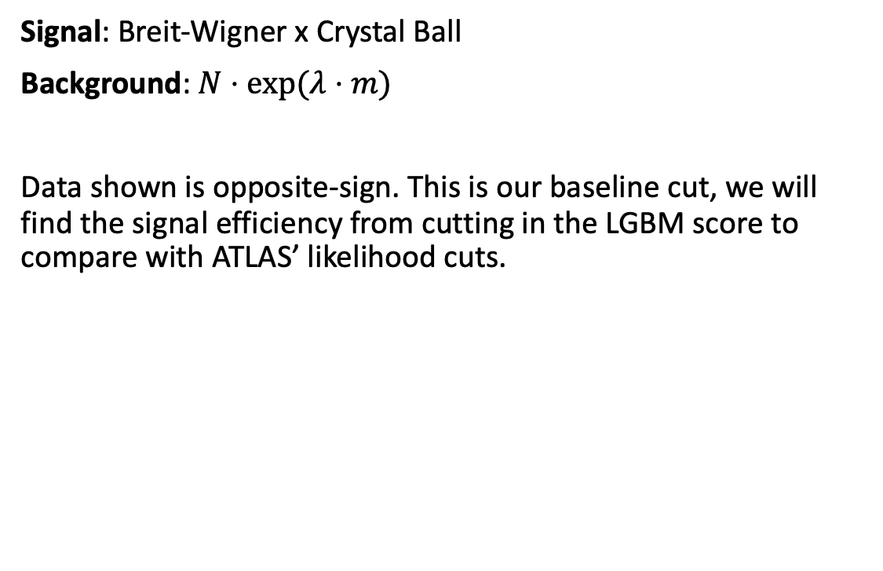
Machine Learning on Data: Fitting Z peak
Signal: Breit-Wigner x Crystal Ball
Background: $N⋅exp⁡(λ⋅m)$
Data shown is opposite-sign. This is our baseline cut, we will find the signal efficiency from cutting in the LGBM score to compare with ATLAS’ likelihood cuts.
Notes:
Antal signal bruges til at udregne efficiency

Slide 28
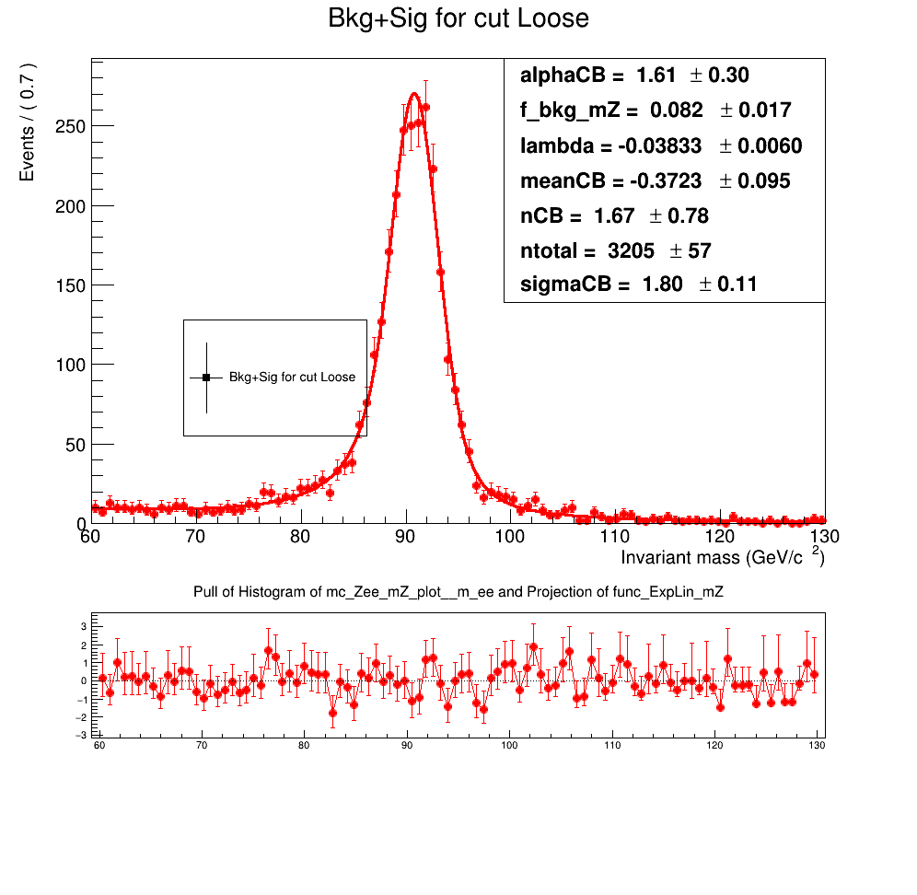
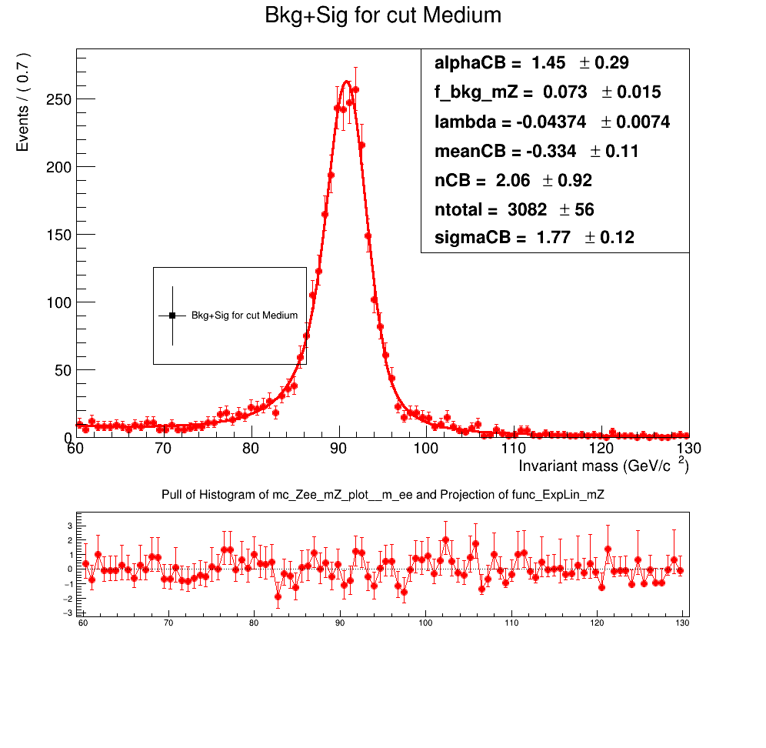
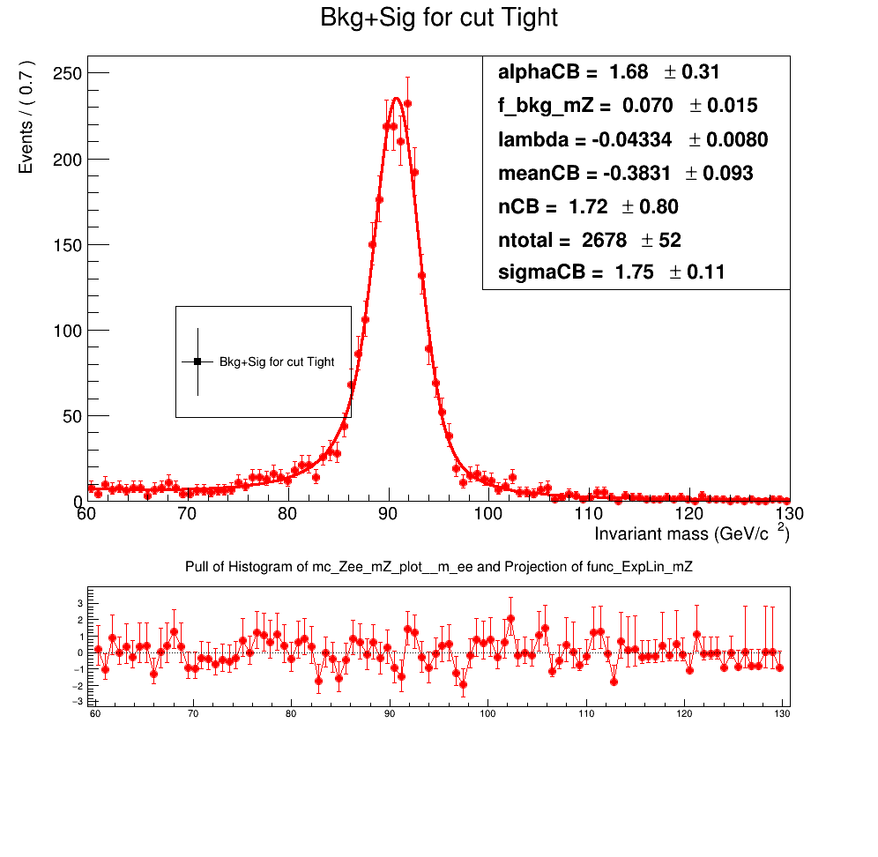
Machine Learning on Data: Fitting Z peak
Using Loose/Medium/Tight selection on opposite-sign

Slide 29
Machine Learning on Data: ”ROC” curve
We look at the signal efficiency for LH cuts and cut in our LGBM score to get the same signal efficiency
We can compare the background efficiencies
For same-sign, we have no signal, but we make the same cut in LGBM as for opposite-sign and count how much background is left.
Ratio plot show the decrease in background at the same signal efficiency
The same plot should be made in MC to compare – we need to get a bigger background sample before this can be done.
Notes:
Opposite sign: We find the same signal eff. as LH cuts and calculate the background eff.
Same-sign: We use the same cut as opposite-sign – how much background is left?

Slide 30
Machine Learning on Data: ”ROC” curve
We look at the signal efficiency for LH cuts and cut in our LGBM score to get the same signal efficiency
We can compare the background efficiencies
For same-sign, we have no signal, but we make the same cut in LGBM as for opposite-sign and count how much background is left.
Ratio plot show the decrease in background at the same signal efficiency
The same plot should be made in MC to compare – we need to get a bigger background sample before this can be done.
Notes:
Opposite sign: We find the same signal eff. as LH cuts and calculate the background eff.
Same-sign: We use the same cut as opposite-sign – how much background is left?

Slide 31
Conclusion
The LightGBM model improves the Z selection for both MC and Data
We will try to get ML PID/ISO trained on Data as input to the Zmm Data model
Next step
Create a ML model on Z ➝ mmγ and H ➝ Z(mm)γ

Slide 32
Bonus slides

Slide 33
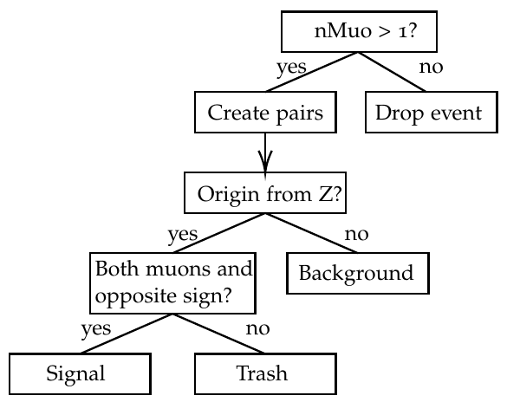
MC model on Zmm: signal selection and reweighing
Notes:
Henrik synes i supplementary

